Slide 1
Accessing Bookeo and Course Documents from the RSN website
You must access your Bookeo account via the RSN website.
www.royal-needlework.org.uk
On the home page click on Classes & Courses at the top of the screen

Slide 2
C &D
Select the Certificate and Diploma page (the cottage image)

Slide 3
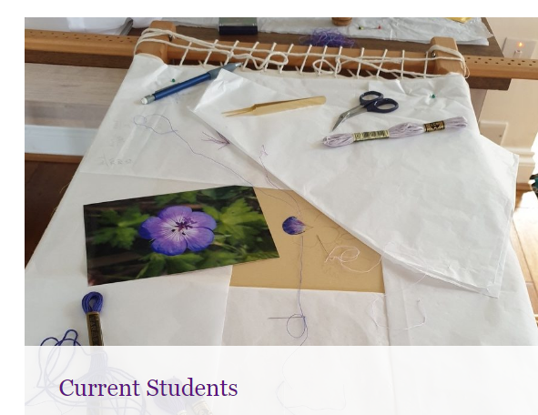
Select Current Students

Slide 4
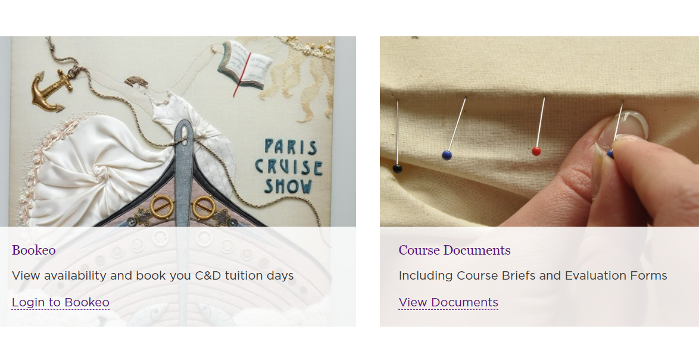
Bookeo or Course Documents
From here you can select Bookeo or Course Documents
In Bookeo you can see the calendar, book book classes, change bookings if they are more than one week ahead, update personal details and change your password.
From Course Documents you can download course briefs, assessment information, evaluation forms, other course admin documentation such as the end of module checklist and notes on framing up and mounting.

Slide 5
Using Bookeo
You must log in to your Bookeo account to book C & D days. This is not the same as an RSN account you may have for the shop etc. The shopping basket on the screen has nothing to do with your Bookeo account.
On the Bookeo page the Sign In box is on the right hand side at the top of the calendar.

Slide 6
Signing in to Bookeo
Enter the email address with which you registered for the C & D.
Enter your password. If you need the password to be reset email education@royal-needlework.org.uk
Sign in

Slide 7
Your Account
The box now changes to “Your account” Clicking on this gives access to:
Making new bookings
Reviewing and changing existing bookings
Updating your contact details
Changing your password.

Slide 8
Select the option you need

Slide 9
Making a booking
Select the venue/course from the drop down list
Select Book
Select option – this is the course you want e.g. Jacobean
Select “First class” if it is.
Select date – Book means the date is available, Wait means you can join the waiting list

Slide 10
Review and Pay
Review your choices then pay.
NB. You do not need a PayPal account to pay by PayPal, just a credit card.
If you want to book more than one date click on the “Add another booking” box.

Slide 11
Changing a future booking
You may only do this if there are at least seven days before the class date. If the date is sooner you must e mail education@royal-needlework.org.uk with a request to amend the booking. It may be subject to a cancellation fee. To make a change….
From “Your bookings” click on the booking to be changed.
In that booking click on the “Change” button alongside the date.
From the list of available classes below select “Book” for the one you want.
Scroll to the bottom of the screen and click on “Next”
Scroll to the bottom of the screen again and tick Agree Conditions and click on “Confirm booking”.
You can click on “Customer Area” to go back to check your bookings.

Slide 12
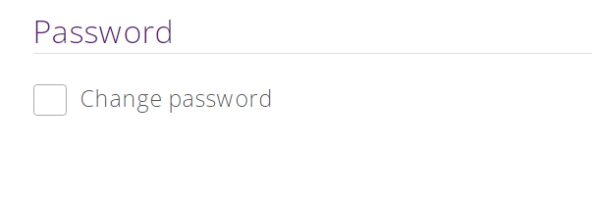
Changing contact details
Select “Your profile”
Amend details and select OK
At the bottom of this page is the option to change your password.

